Slide 1
Topic: Measurement
EQ: How do we calculate the perimeter of all 2D shapes?
Get your VIVO’s
Have you set up Interactive Notebook
Have you accessed your Mathspace account
Have you checked the notices on Connect
Have you got a scientific calculator
Notes:
Cardboard cover needs to have Term 1 and Term 2 assessment outlines
Mathspace passwords

Slide 2
With shoulder partner: 1. Complete perimeter foldable-15mins These will form your notes 2.Glue in on RHS of INB

Slide 3
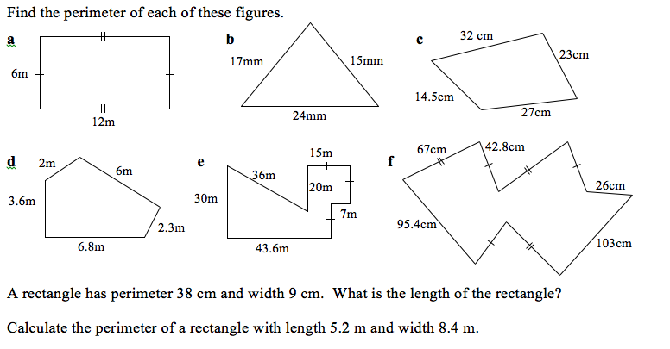
Task- 15mins
Early Finishers- Pg 12-13 MAWA Text Question 1 & 2 only

Slide 4
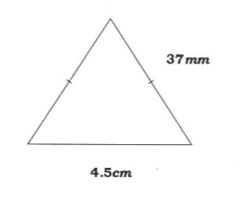
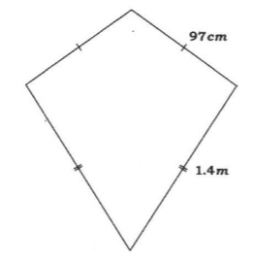
Exit Pass
1. Look at the questions have on the post it note tell me why these questions are a little harder
2. Complete the questions by showing communication AND THEN the answer
1. |  | 2.
Notes:
Cardboard cover needs to have Term 1 and Term 2 assessment outlines
Mathspace passwords

